Slide 1
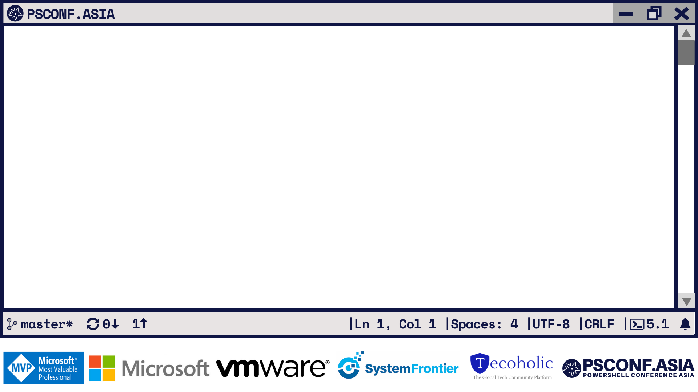
Ansible module execution on Windows using PowerShell
Prasoon Karunan V Software Technologist

Slide 2
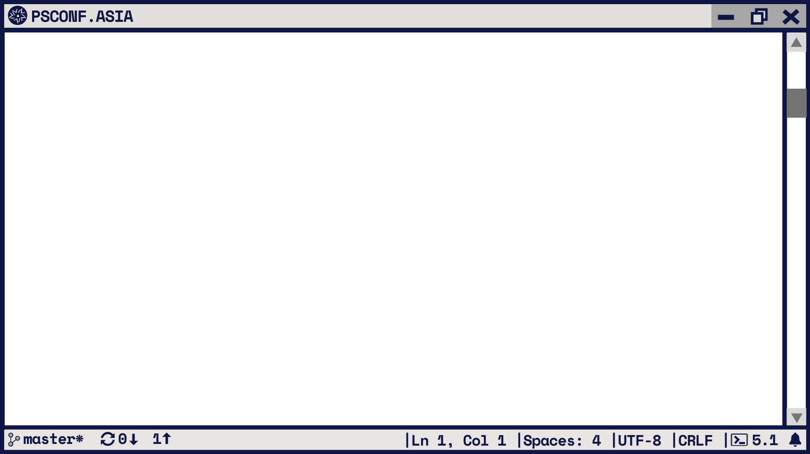
>_ Get-Help About_Me
Prasoon Karunan V - Just another PowerShell fan
Mostly show up as kvprasoon
Software Technologist @ Philips
Tweets @prasoonkarunan
Senior forum moderator @ PowerShell.org
PowerShell community hero 2019

Slide 3
>_ Show-Agenda
Configuration Management and Ansible
Basic components in Ansible
Ansible on Windows
Custom module – Code walkthrough
Demo
Execution internals
QnA

Slide 4
>_ Get-Help About_Configuration_Management
Configuration management(CM) is a process of ensuring and tracking the expected state of a system, where the system can be a single computer or a complex IT infrastructure. CM is used to configure Operating systems, Applications, Networks etc.
CM tools: Chef, Puppet, Ansible, PowerShell DSC, Saltstack etc.

Slide 5
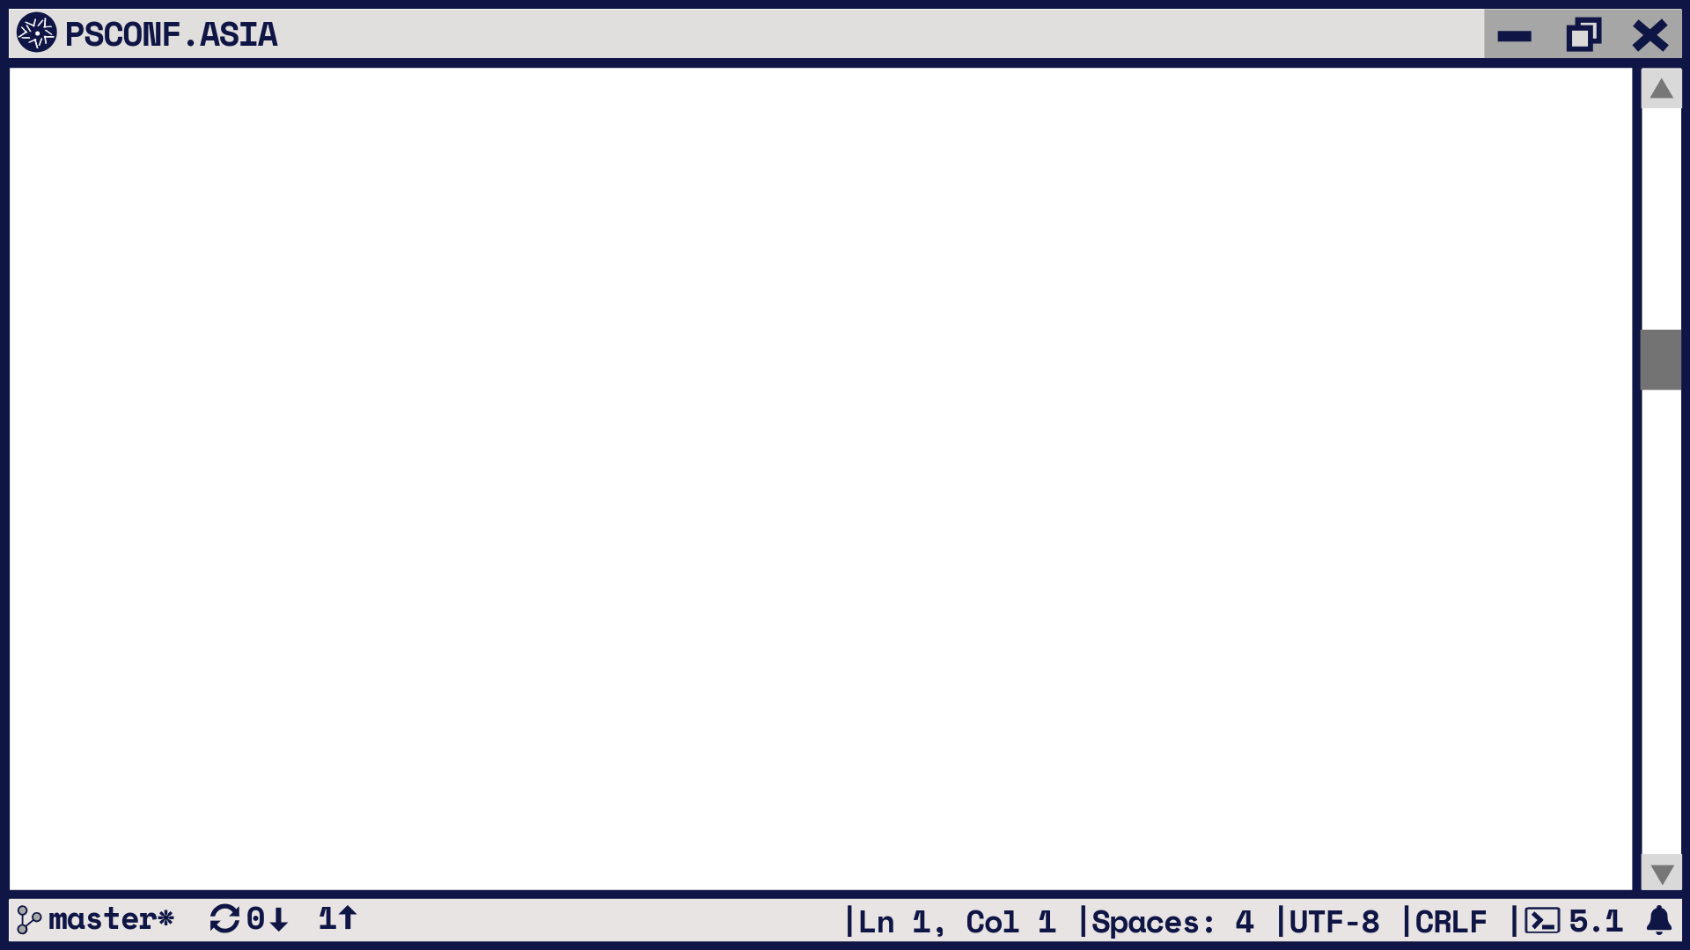
>_ $Ansible
Another configuration management and orchestration tool
Requires a Linux OS to run - Ansible Controller .
It’s a CM tool, so uses Declarative syntax.
Agentless
Uses YAML as configuration file.
Uses SSH by default as connection plugin.

Slide 6
>_ Compare-Object $AgentBased $AgentLess
Agent based
Good as there isn’t much load on the controller/master node when targeting a large number of nodes.
But agents has to be pre installed and configured on each of the target node.
Agentless
Controller has to handle concurrency when targeting large number of nodes.
But zero configurations required in the target node.

Slide 7
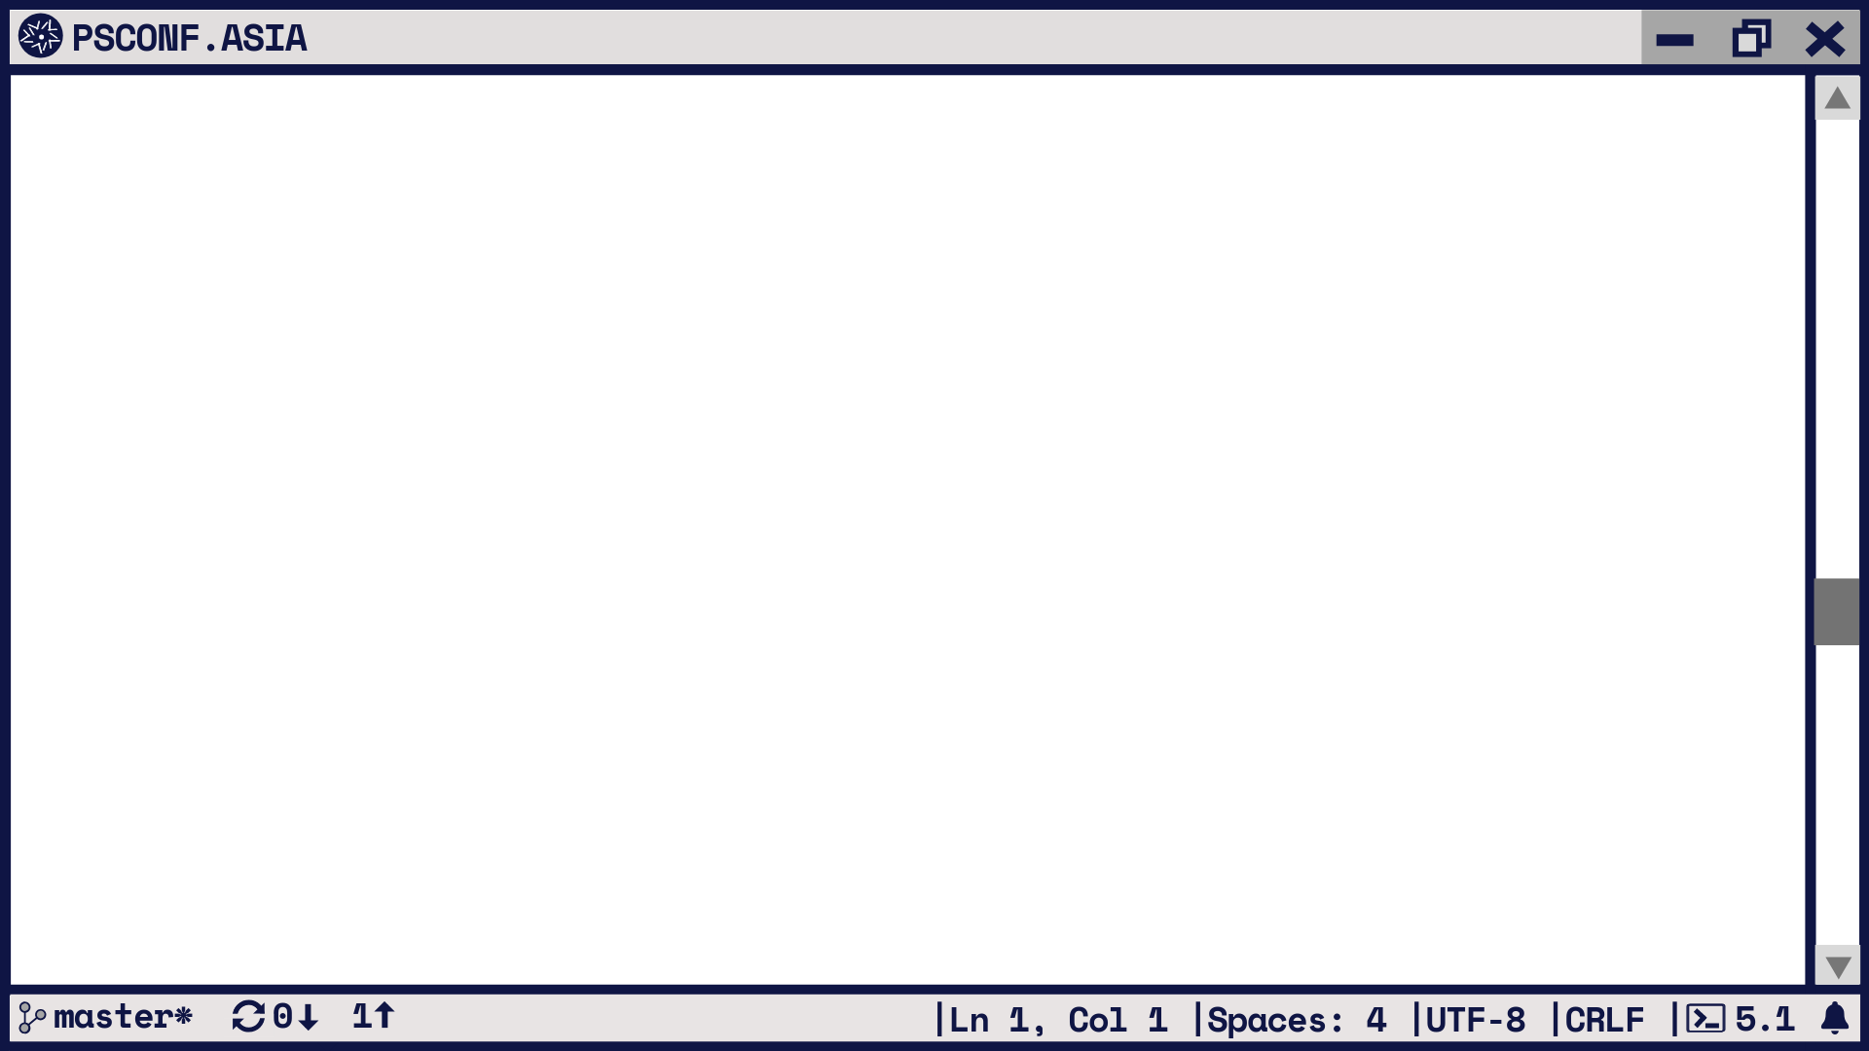
>_ $Ansible.Windows
Still agentless
Connection plugins.
WinRM – uses pywinrm to connect from Ansible controller to Windows node.
PSRP – uses pypsrp plugin to connect to Windows node.
SSH with Win32-OpenSSH – OpenSSH has to be installed in target node.
Requires min PowerShell 3.0 on target node.

Slide 8
>_ $Ansible.BasicComponents
Playbook
Task
Module
Variable
Inventory file
Host variables
Ansible configuration (ansible.cfg)

Slide 9
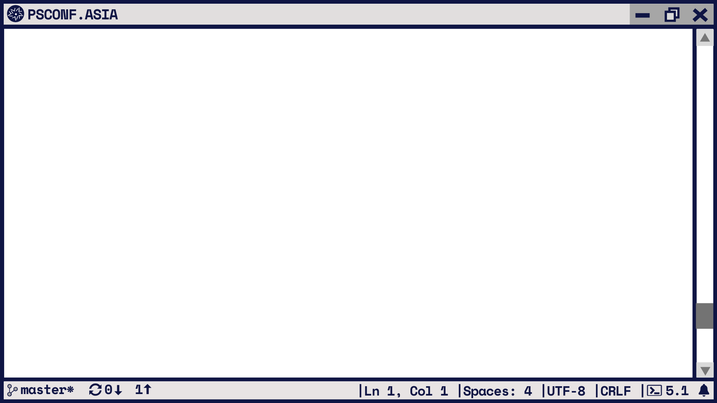
>_ Get-Content .\inventory.ini
[win20191]
192.168.1.150
[win20191:vars]
ansible_user = administrator
ansible_password = c00l@abc
ansible_connection = winrm
ansible_port = 5985
ansible_winrm_transport = ntlm
ansible_winrm_server_cert_validation = ignore

Slide 10
>_ Get-Content .\playbook.yml
---
- hosts: win20191
gather_facts: false
tasks:
- name:
win_auto_logon:
user: ansible
password: P0wer$hell1
state: present
register: output - debug:
msg: "{{output}}"
>_ Code .\win_auto_logon.ps1

Slide 11
>_ Start-Demo

Slide 12
>_ Tell-Me “What happens in controller”
The Task Executor
Receives the module name and parameters.
Loads the Normal Action plugin
Loads the connection plugin (WinRM in our Demo)
Uses module_common.py to executes the module on remote node.
Decides whether it’s a PowerShell or Python based module
Passes the module to Assembler framework(Module replace f/w for PowerShell)

Slide 13
>_ Tell-Me “What happens in windows node”
$String | PowerShell &{BootstrapWrapperCode}
Create json_arg variable (string[0])
.ps1
Executes ExecWrapperCode (string[1])
ExecWrapper.ps1
Defines and loads helper functions
Invokes ModulePowerShellWrapper code
Takes payload as input (converted from json_args)
Creates and Import AddCsharpType module
ModulePowerShellWrapper.ps1
Invokes ModuleWrapper code
ModuleWrapper.ps1
Takes helper funcs, cust_module, module_args, env_vars, helper_modules and module_name
Initiate a PowerShell instance ([PowerShell]::Create())
Creates modules in memory and imports them
Adds variables, helper func, custom_module to the PS instance
Invoke the PowerShell instance
Returns output/errors
win_auto_logon.ps1

Slide 14
Gets the input data as string and executes the bootstrapper code
Split the string to json data and ExecWrapper code
Decides if PowerShell or python module and executes on target node
Defines and load helper functions, then executes ModulePowerShell wrapper code
Loads the connection plugin(WinRM/ssh)
Import C# helper module and executes ModuleWrapper code
Task executer receives the module name and parameters
Creates PowerShell instance, executes module and returns the output
Trigger ansible-playbook
</>
Receives the output

Slide 15
>_ $References
Ansible:
- Start here: https://docs.ansible.com/ansible/2.8/index.html
- Architecture: https://docs.ansible.com/ansible/2.8/dev_guide/overview_architecture.html
- Module architecture: https://docs.ansible.com/ansible/2.8/dev_guide/developing_program_flow_modules.html
- WinRM plugin: https://docs.ansible.com/ansible/2.8/plugins/connection/winrm.html
- Ansible repo: www.github.com/ansible/ansible

Slide 16
